Slide 1
Tintri Customer Review

Slide 2
Brief Introduction
Gene Liverman
SRE @ Puppet
Formerly SysAdmin @ University of West Georgia
Windows, Linux, Mac, & Solaris
Storage, Firewalls, Load Balancers, etc.
Why Tinri?
The latency box:

Slide 3
Puppet
Company Summary
Current IT Focus & Goals
IT Operations
Organization model of IT to support Puppet’s business units and “Customer needs”
Tintri at Puppet
Current “Private Cloud” Use Cases in use
Orchestration MGMT of the Tintri systems
Whats next?
Conclusion

Slide 4
Puppet in a nutshell
Puppet automates the delivery and operation of the software that powers our world.
More than 37,000 companies rely on Puppet to confidently drive software changes.

Slide 5
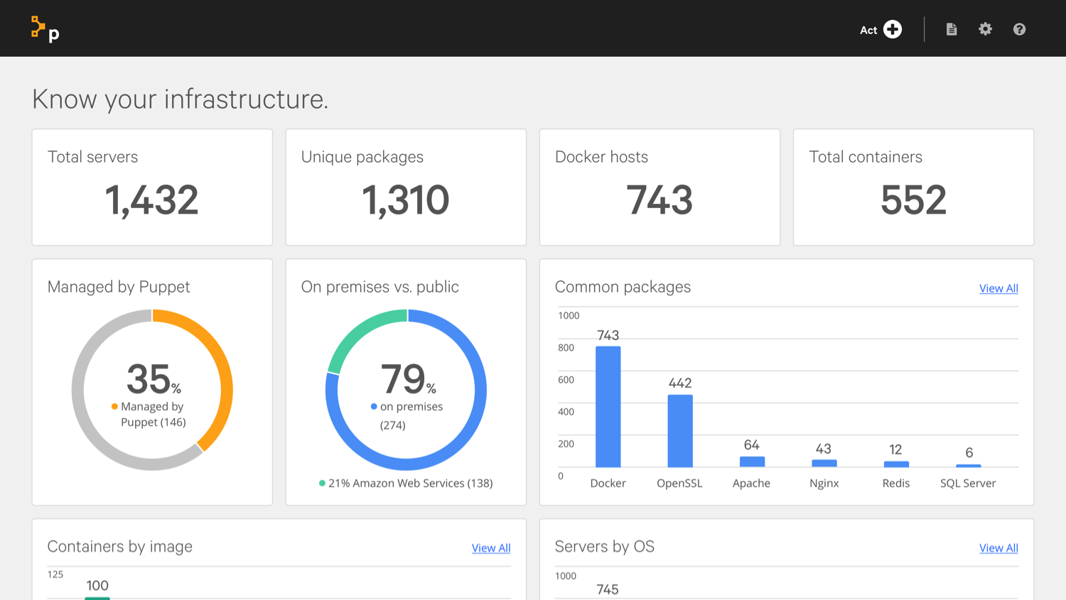
Puppet Product Portfolio
Puppet Discovery
Puppet Enterprise
Puppet Pipelines
Know what you have. Know where to start.
Start simple and scale. Keep it compliant.
Bridge dev and ops automation silos.
For more information, visit puppet.com

Slide 6
Puppet’s Open Source Products
Puppet Bolt
Lumogon
Open source Puppet
Tons of Puppet modules

Slide 7
Areas of focus
OpenStack redo
Managed
Centralized storage
Re-architecting internal PE environment
more flexible + easier deployment
Updating and stabilizing VMware
We beat up API’s
More consistency, more capacity, more maintainable

Slide 8
IT at Puppet
SRE
InfraCore
Runs most infrastructure
Quality Engineering
Builds and operates testing tools
Release Engineering
Gets things out the door
BTO
Help Desk
Internal end user support
IT Ops
Networking
DC Ops
Auth
BizApps
All the apps that help us get stuff done

Slide 9
Tintri at Puppet
Replacing home-grown storage
ZFS + x86 Solaris on Super Micro and UCS
All-flash unit for CI
Consistent performance is key
Hybrid unit for static servers
Cheap and deep + some flash
Backing production VMware
Backing OpenStack playground

Slide 10
Dashboarding
We use Grafana
Tintri provides API access
tintri-stats was born
Pre-built Docker container
Supports OpenShift S2I
Reads from Tintri
Writes to Graphite

Slide 11
Software Deployment Automation
Process:
Shutdown VM
Snapshot on Tintri
Boot VM back up
Goals:
No point and click
Written in Python
Support multiple VMs
tintri-vmware-snapshotting
Calls VMware API to shutdown a VM
Calls Tintri API to take a snapshot
Calls VMware API to boot a VM
Utilizes VMware tools when available

Slide 12
Tintri APIs
Why no swagger?
Publish library to PyPI

Slide 13
What’s next for Tintri at Puppet?
Finish migrating static VMware servers onto hybrid array
Install VAAI plugin on all hosts
Utilize snapshot offloading for GUI actions
Connect OpenStack environment via Cinder
Investigate integrating Tintri and vmpooler
Snapshots?
Cloning?
Performance / latency info?
https://github.com/puppetlabs/vmpooler

Slide 14
Word of Advice
Kubernetes support needed
Talked about in press release on Nov. 1, 2016
Talked about again by Dan Florea on March 28, 2017
Even Docker, Oracle, and Microsoft support it
More hypervisor integrations
Nutanix’s Acropolis
Pure KVM
Offer virtual appliance as DR replication target
ExaGrid does this and backs it with an S3 bucket

Slide 15
Word of Advice
Not everything is a VM or container…
Support basic file shares from a submount
Docs need some love
vCenter plugin has nothing for v6.5
Basic setup info is missing for both vCenter plugin install and VAAI plugin

Slide 16
Gene Liverman
gene.liverman@puppet.com
genebean.github.io/talks
github.com/genebean
@technicalissues

